Slide 1
Phase rotation
PowerPoint presentation
Unit 304: Electrical Installations: inspection, testing and commissioning

Slide 2
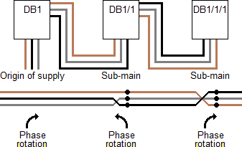
Phase rotation
Correct phase sequence means that the phase sequence of the incoming line conductors (i.e. Brown – L1; Black – L2; Grey – L3) is the same throughout the whole installation.

Slide 3
Phase rotation
Optionally and occasionally, the inspector may wish to check phase sequence by using a phase rotation tester, either
rotating disc type, or
indicator lamp type.
Instruments containing both of the above forms of indicators are also available.

Slide 4
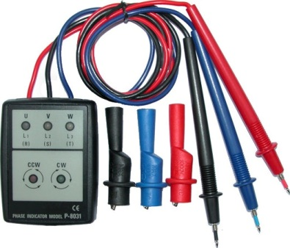
Phase rotation

Slide 5
Any questions?

